Slide 1

E-COMMERCE DATAWAREHOUSE
Data engineer – rocco caliandro

Slide 2
REQUIREMENTS
The gathering of requirements is obtained by the client via email through a document in the attachments with all the specifications for the project
The objective of the project is to design and implement an ETL data flow for a B2B e-commerce website.
Integration and transformation of the data coming from different systems and with a different format

Slide 3




Data sources
B2B platform database (Relational DB)
Log files coming from the web server
Marketing lead login spreadsheet file

Slide 4
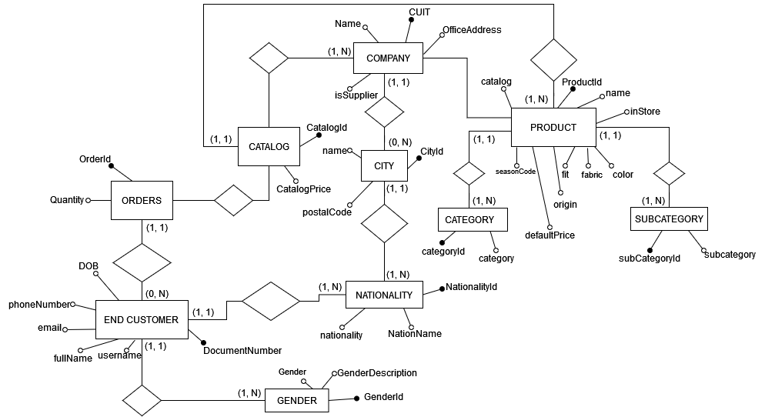
ER DIAGRAM E-COMMERCE RELATIONAL DBMS
10 Entities
10 Relations
1-1
1-N
N-N

Slide 5






SERVER LOG
WEB SERVER
Row Example
207.81.204.168
-
sonia
[2022-10-05 14:37:13.186787]
"POST /api/suppliers/ HTTP/1.1"
200
7037
"http://www.duncan.info/homepage/"
"Mozilla/5.0 UserAgent"
CLIENTS
HTTP Requests
LOG
Log
Generator
Log Generator simulated by python
Using the following LogFormat:
"%h %l %u %t \"%r\" %>s %b \"%{Referer}i\" \"%{User-agent}i\""

Slide 6

External files
External files are used to integrate data that is not present in other sources
External files can be easily managed by the client
Example of this kind of files are: .xls, .xlsx, .csv, .txt, .doc and so on
In our project the external files is composed by two Excel spreadsheets:
OrderId, OrderDate, Status, OrderAddress, Courier
OrderStatus.xls
username, LastLoginDate, Device, Country
UserLogin.xls

Slide 7
Design of the datawarehouse
Knowledge in detail all the datasources
Conceptual Design: Creation of the DFM (Data Fact Model) in order to define the relations between facts and dimensions
Creation of an appropriate structure for our DWH according the DFM
Import Area (TT)
Cleaning Area (T)
Staging Area (SA)
Datamart Area (DM)
Naming convention
for tables
Import
Cleaning
SA
DM

Slide 8
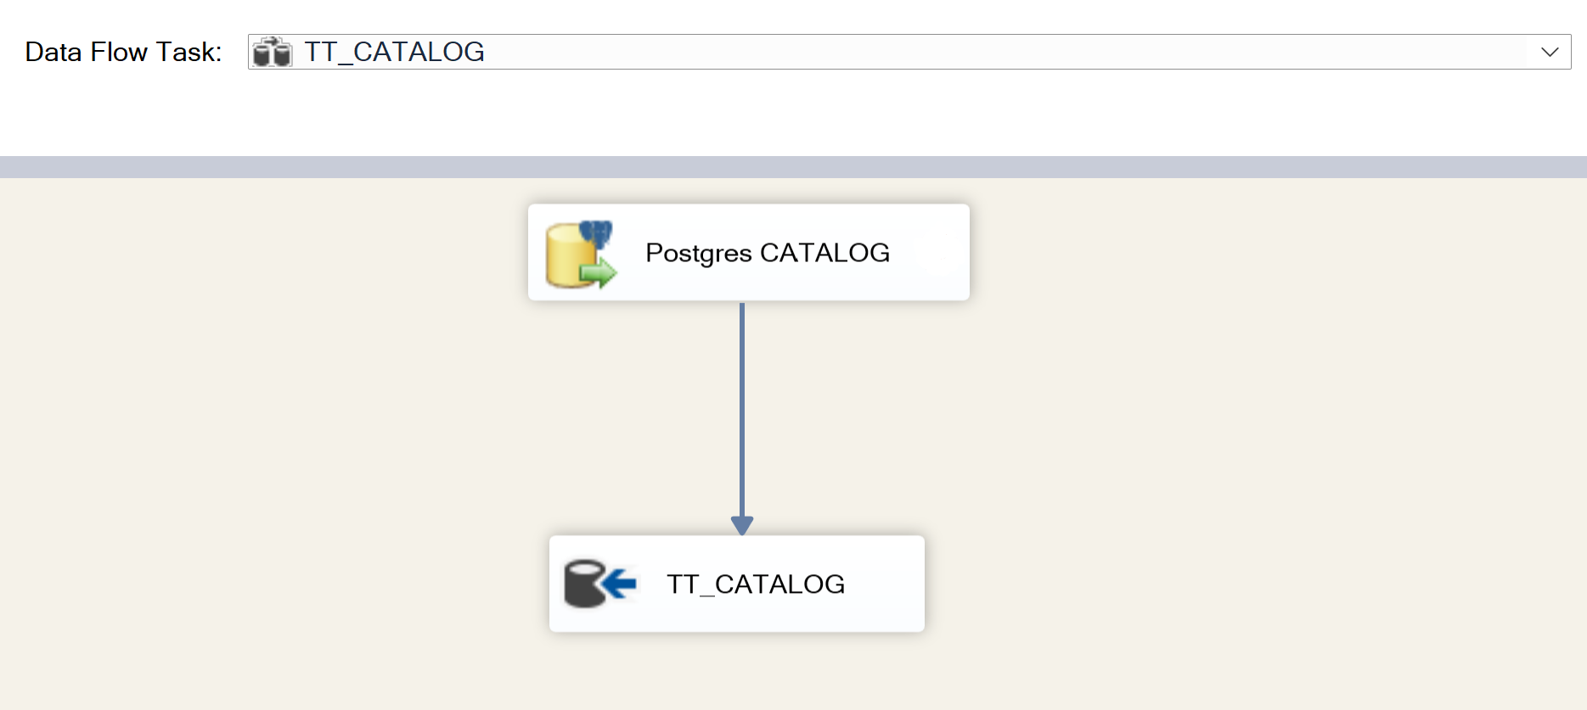
Import area (TT)
Import of tables from data sources
In our project we have one package for each data source
Usually, the package truncate first all the tables and
then insert the values by reading the source
In our project we apply a full-refresh strategy
Output: TT_CATALOG
Example:

Slide 9
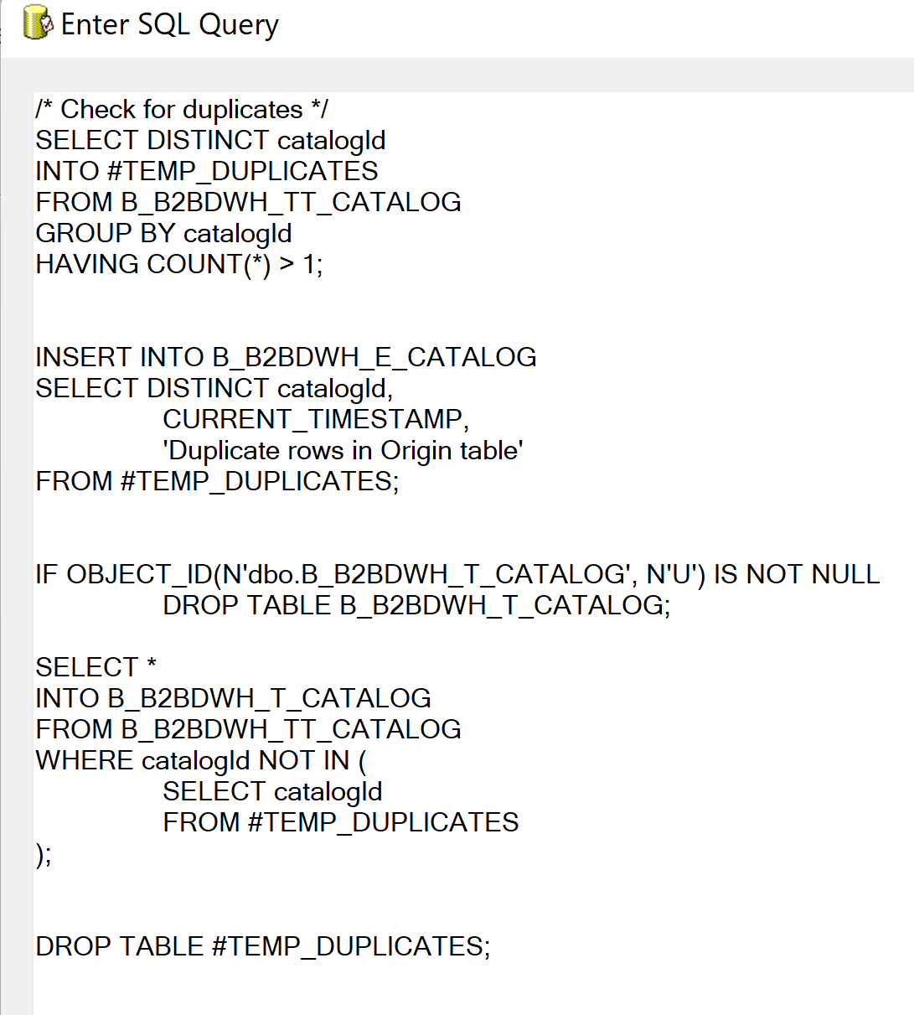

CLEANING AREA (T)
Execution of SQL Task in SSIS
In our project we first check for duplicates (two rows
in the source with the same ID
Then data with errors are managed by E_ tables and they are
not included in the system
In this phase there are other cleaning strategies like management of NULLs
Finally, we populate the T_ tables that represent our cleaned import by using again a full-refresh strategy
Output: T_CATALOG
Example:

Slide 10
Staging area (sa)
Definition of the logical design
Starting from the logical design, creation of the logical model
Dimension (by convention the tables are denoted with the letter S in Staging Area and with the letter L in Datamart)
Facts: (by convention the tables are denoted with the letter SF in Staging Area and with the letter F in Datamart)
The logical model shows how facts and dimensions are related and define attributes, measures and KPI
It is very important to notice that SA is the most complex component of the DWH because in this area we implement the business logic in order to create facts and dimensions

Slide 11
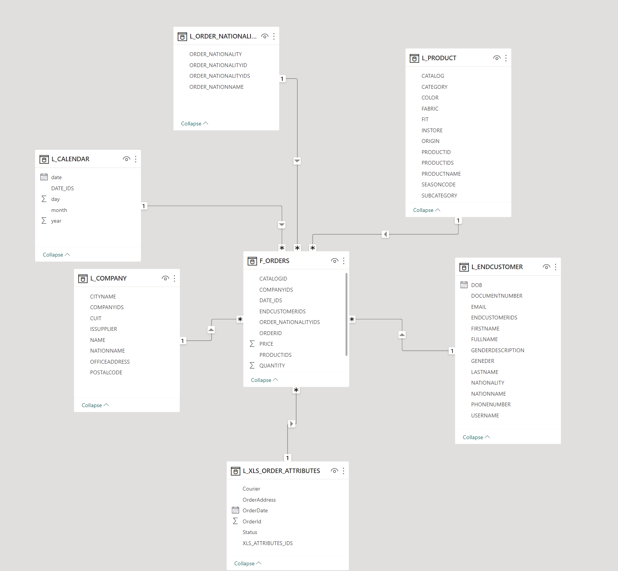
Staging area (sa)
Example: F_ORDERS
Star schema composed by:
4 Facts
SF_ORDERS, SF_LAST_LOGIN, SF_PRODUCT_SUPPLIER, SF_SERVER_LOG
10 Dimensions
S_CALENDAR, S_COMPANY, S_CUSTOMER_NATIONALITY, S_DEVICE, S_ENDCUSTOMER, S_ORDER_NATIONALITY, S_PRODUCT, S_SERVER_LOG, S_SUPPLIER, S_XLS_ORDER_ATTRIBUTES
In the image we only consider the fact F_ORDERS and related dimesions

Slide 12
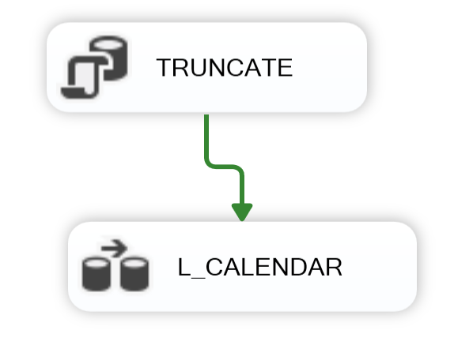
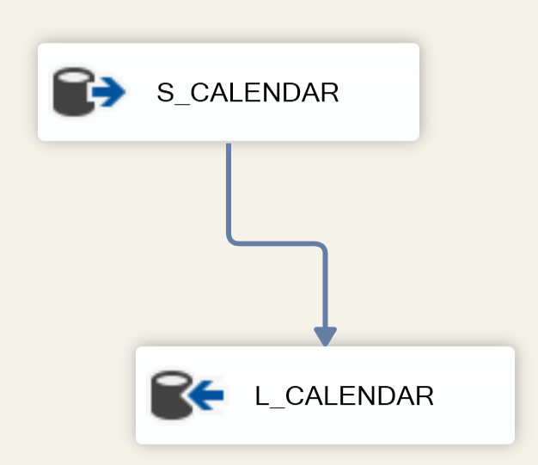
Data mart (dm)
Very last step of the Business Intelligence data flow.
Usually read the facts and dimensions from the staging area (previous step) and populate the DM tables
Step 1 Truncate of the L or SF
Step 2 Dataflow from S to L (or SF to F)

Slide 13
Data VISUALIZATION
Data visualization is the graphical representation of information and data
By using visual elements like charts, tables, maps and so on, data visualization tools provide an accessible way to see and understand trends and patterns in data
One of the applications of Data Visualization is to create report or dashboard to the final user in order to show them how data is elaborated by BI tools (show elaborated data instead of raw data
There are many tools that allow us to create a graphical representation of data
Most common tools are: PowerBI, Tableau, Qlik, Google Charts and so on…
The tool used in our project is PowerBI

Slide 14
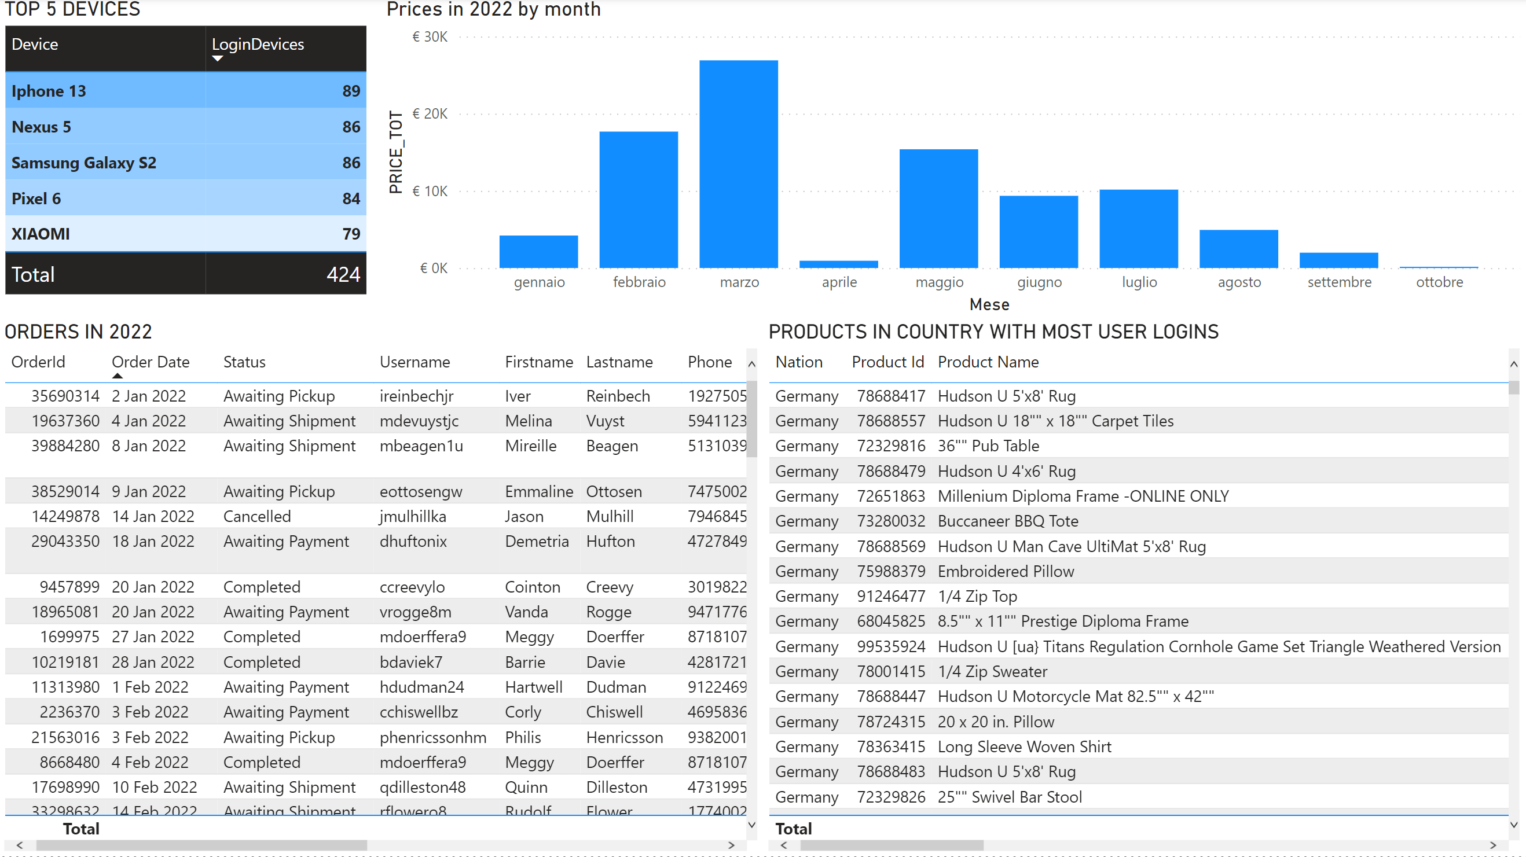
Final report
Requirements:
Top 5 devices
Products in country
with more logins
Last year sales

Slide 15

Thank you!
Rocco caliandro

